Slide 1

DESCRIPTIVE ANALYTICS
Practical: Union of Tables
PRESENTED BY
Priyanshi
Akhilesh Mishra
Kumar Vaibhav
PRESENTED TO
Mr. Ferhan Ahmed
IBM Trainer
United University

Slide 2
Introduction to Descriptive Analytics
Descriptive Analytics summarizes and explains existing or historical data.
It helps identify patterns, trends, and useful information in datasets.
Businesses use it to review performance and prepare reports.
Our practical combines employee records using Union of Tables.

Slide 3
Practical Idea & Objective
Idea: Combine employee records stored in two separate tables.
Use Employee_January and Employee_February as input tables.
Apply Union of Tables in IBM Cognos Analytics.
Create one combined table for easier viewing and further analysis.

Slide 4
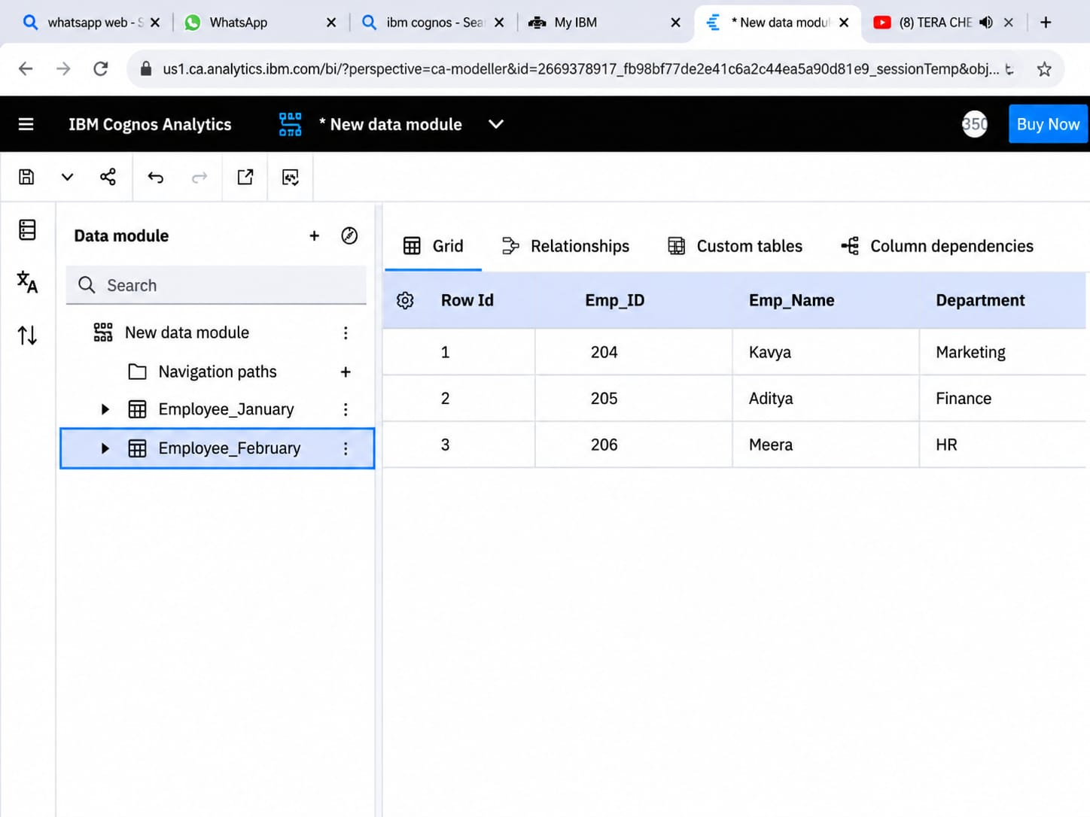
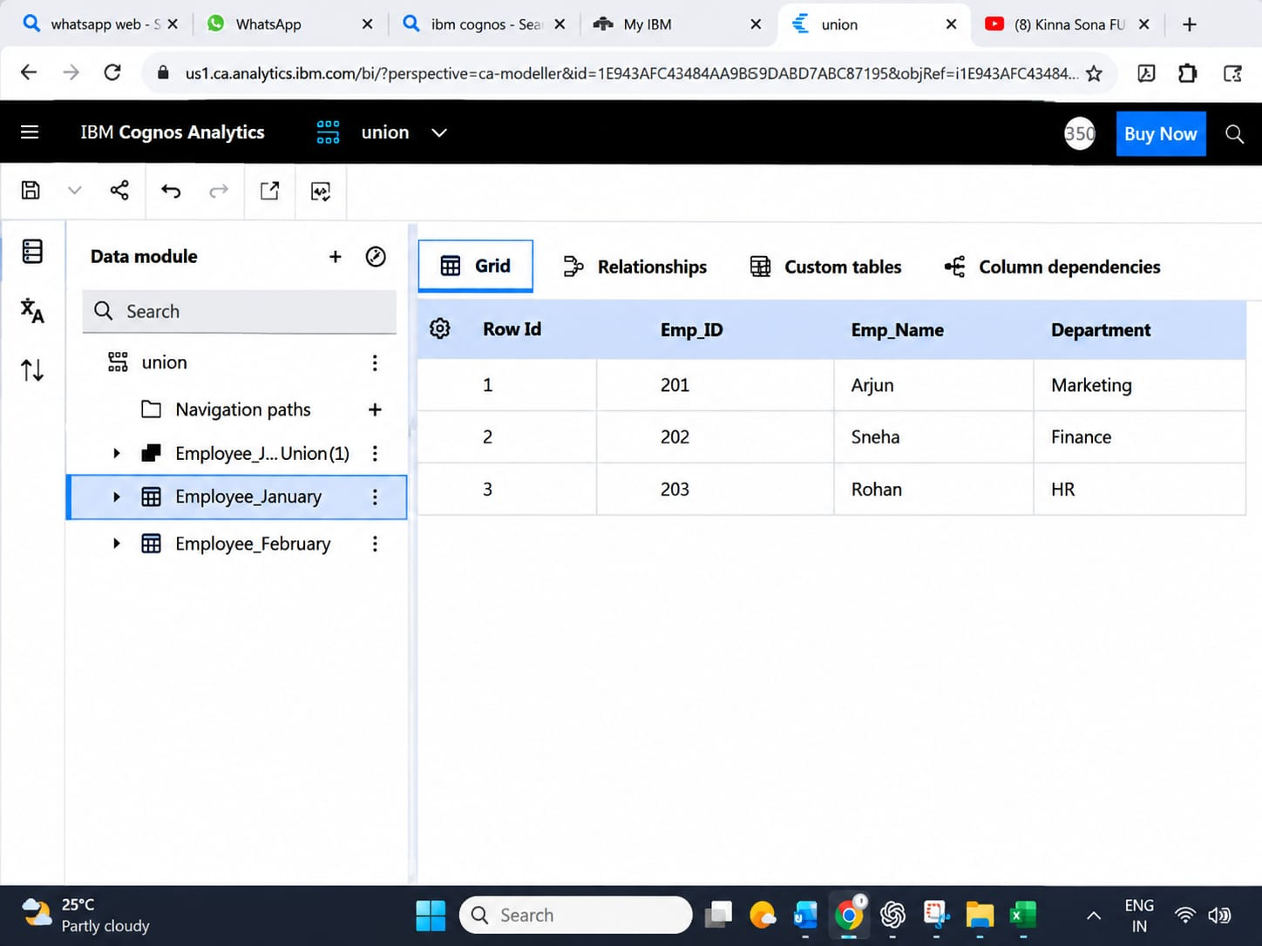
Input Datasets
Employee_January and Employee_February

Slide 5
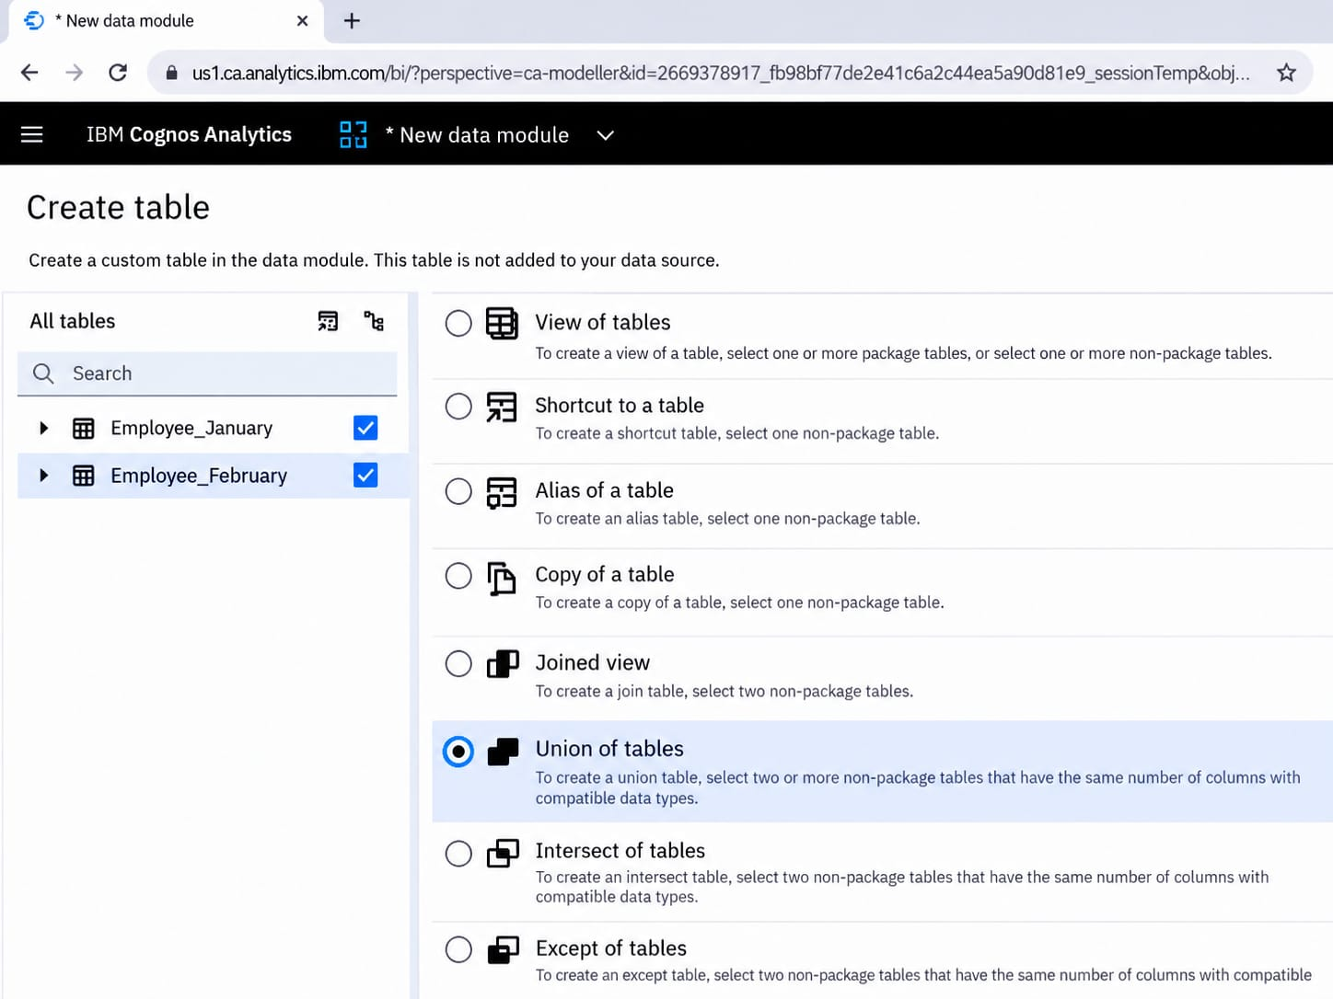
Application of : Union of Tables

Slide 6
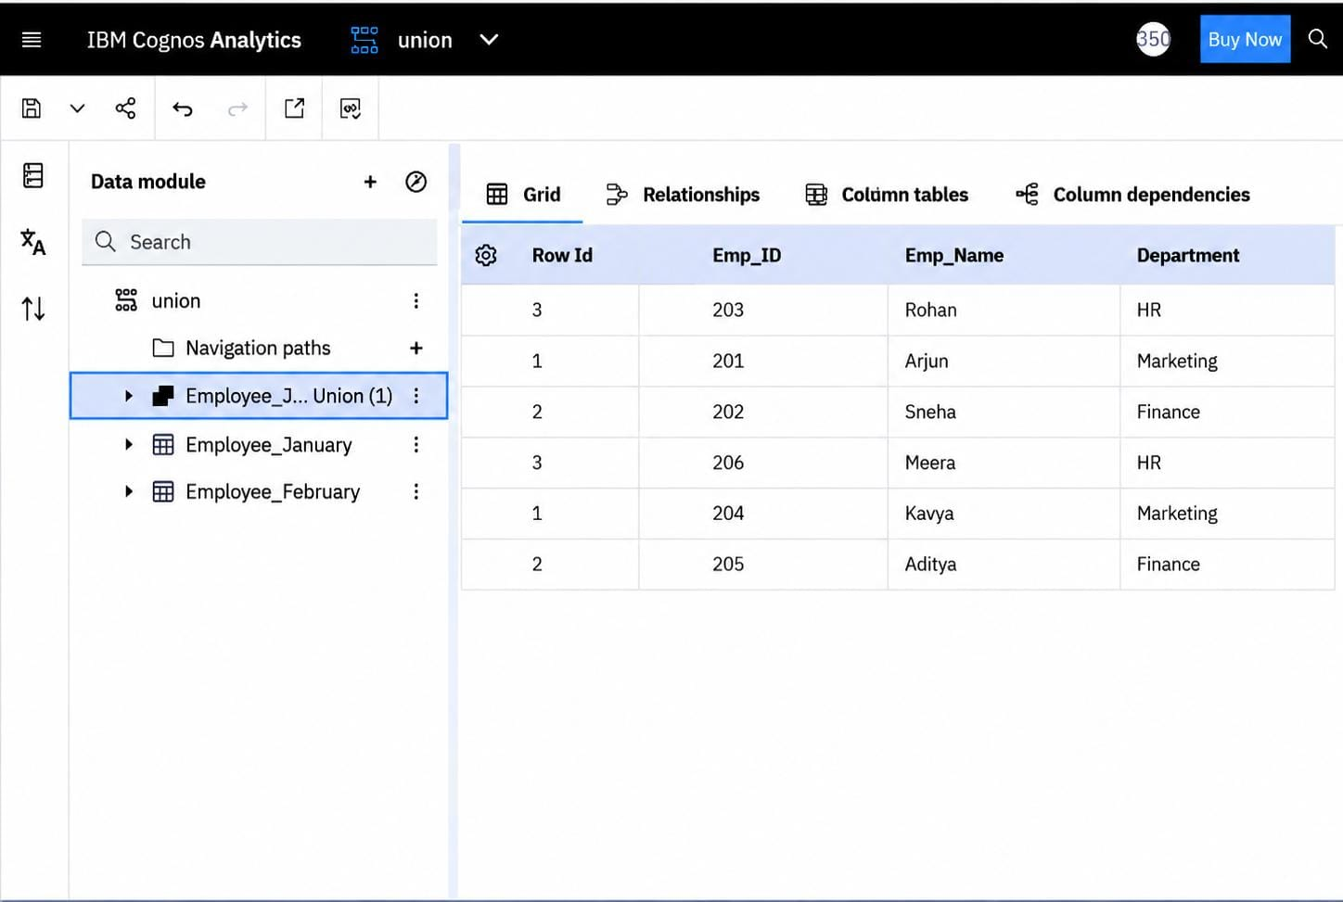
Practical Output
Combined employee records

Slide 7
Procedure & Key Learning
Open the data module in IBM Cognos Analytics.
Select Employee_January and Employee_February.
Choose the Union of Tables option.
Ensure both tables have the same number of columns with compatible data types.
Create the union table and review the combined records.

Slide 8
Conclusion & Learning Outcomes
Union of Tables combines rows from multiple compatible tables.
The practical brought employee records from January and February together.
The combined table makes employee information easier to review.
This exercise strengthened our understanding of data preparation in IBM Cognos Analytics.

Slide 9


